Slide 1
Chat App
Joe O’Brien and Ricky Hodge

Slide 2
Application Scenario
Communication is a huge part of everyday life
Important to stay in touch with friends, families, coworkers, etc.
Chat App is a simple communication method that can be expanded upon as our knowledge and understanding of Java grows.

Slide 3
What Can Chat App Do?
Allows for the communication between two users
Takes user input and displays it on the UI
Provides accurate timestamps on each message
Can be expanded in the future fairly easily

Slide 4
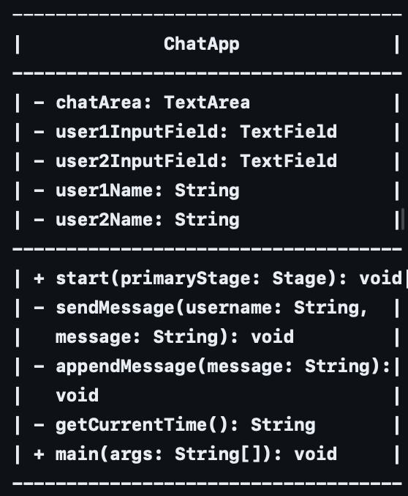
UML Diagram/Implementation
Implementation:
Main Class Structure:
The ChatApp class extends Application, which is the entry point for JavaFX applications.
It contains variables for UI components (chatArea, user1InputField, user2InputField) and user-related data (user1Name, userName).
The class implements methods such as start, sendMessage, appendMessage, and getCurrentTime, as well as the main method.

Slide 5
Implementation cont.
UI Setup (start Method):
The start method initializes the UI components using JavaFX classes (BorderPane, VBox, TextArea, TextField, Button).
It sets up event handlers for button clicks (user1SendButton, user2SendButton) to send messages.
Dialog boxes (TextInputDialog) are used to prompt users for their usernames (user1Dialog, user2Dialog).
Message Handling:
The sendMessage method processes and sends messages entered by users, and adds a timestamp.
The appendMessage method updates the chat area with the sent message using Platform.runLater.
Time Formatting:
The getCurrentTime method formats the current time in the "HH:mm:ss" format using SimpleDateFormat.

Slide 6
What We Learned
Better understanding of Java/Javafx
Would like to improve upon the user interface of Chat App
Implement server/sockets to allow communication between two devices

Slide 7
Demo
https://youtu.be/ZdGhlbdc4d8?si=cdqYBNsQf10LTx21

